Slide 1

BITICOIN PRICE PREDICTION USING Machine learning
Presented By
→Student Name: K.Kapil
→College Name: Annamacharya institute of technology and sciences
→Department: artificial intelligence and machine learning
→Email ID:6302516564kapil@gmail.com
→AICTE Student ID: ainsi_96080

Slide 2
OUTLINE
Problem Statement
Proposed System/Solution
System Development Approach (Technology Used)
Algorithm & Deployment
Result
Conclusion
Future Scope
References

Slide 3
Problem Statement:
Bitcoin, the world's most popular cryptocurrency, exhibits high volatility, making accurate price prediction challenging yet crucial for investors, traders, and financial institutions. Traditional financial models struggle to capture the complex and nonlinear dependencies in Bitcoin price fluctuations. Leveraging machine learning techniques can provide more reliable predictions by analyzing historical price trends, market sentiment, trading volume, and other influential factors.

Slide 4
Proposed Solution:
A solid approach to predicting Bitcoin prices with machine learning involves several key steps. Here's a structured proposed solution:
1. Data Collection & Preprocessing
Gather historical Bitcoin price data from sources like Coin Gecko, CornmarketcCap, or blockchain APIs.
Include additional financial indicators like trading volume, market sentiment, and macroeconomic trends.
Perform data cleaning (handling missing values, removing anomalies) and normalization to ensure consistency.
2. Feature Engineering
Extract relevant features such as moving averages, volatility indices, RSI (Relative Strength Index), MACD (Moving Average Convergence Divergence).
Incorporate external factors like Google Trends data, news sentiment analysis, and social media discussions.
Create lag features to capture temporal dependencies for time-series forecasting.
3. Model Selection & Training
Compare different ML models such as:
Linear Regression, XGBoost, Random Forest (for simple price predictions).
LSTM (Long Short-Term Memory), GRU (Gated Recurrent Units) for deep-learning time series forecasting.
ARIMA, Prophet for traditional time-series modeling.
Split data into training, validation, and test sets to ensure robust evaluation.

Slide 5
4. Model Evaluation & Optimization
Use performance metrics like RMSE (Root Mean Square Error), MAE (Mean Absolute Error), and R² Score.
Fine-tune hyperparameters using Grid Search or Bayesian Optimization.
Implement techniques like dropout, batch normalization, and regularization for deep-learning models.
5. Real-Time Prediction & Deployment
Develop a real-time prediction pipeline using Flask, FastAPI, or Django.
Deploy the model on AWS, Google Cloud, or Azure for scalability.
Integrate an API for real-time price predictions based on live market data.
6. Visualization & Interpretation
Build an interactive dashboard using Plotly, Tableau, or Power BI.
Showcase predictions, market trends, error analysis, and model performance.
Would this approach work for your project, Kapil? Let me know if you want to refine it further! 🚀📈

Slide 6
System Approach
A system approach to Bitcoin price prediction using machine learning involves structuring the project as a pipeline with interconnected components. Here's how you can design a robust system:
1. Data Acquisition Layer
Source Identification: Gather historical Bitcoin prices from APIs (CoinGecko, CoinMarketCap) and financial datasets.
Live Data Streaming: Fetch real-time price updates using WebSocket connections from exchanges (Binance, Kraken).
External Data: Incorporate macroeconomic indicators, social media sentiment (Twitter, Reddit), and Google Trends.
2. Data Preprocessing & Feature Engineering
Data Cleaning: Handle missing values, outliers, and anomalies.
Feature Extraction: Include technical indicators like Moving Averages, Bollinger Bands, RSI, MACD.
Sentiment Analysis: Perform NLP-based analysis on cryptocurrency news & social media posts.
Normalization & Scaling: Use Min-Max scaling or Standardization to prepare data for ML models.
3. Machine Learning Model Selection
Traditional Models: ARIMA, VAR, XGBoost (for structured data).
Deep Learning Models: LSTM, GRU, Transformer-based architectures (for sequential data).
Hybrid Models: Combining statistical and ML models to enhance accuracy.

Slide 7
4. Model Training & Evaluation
Hyperparameter Optimization: Use Grid Search, Bayesian Optimization for fine-tuning models.
Performance Metrics: Evaluate predictions using RMSE, MAE, R² score, accuracy.
Cross-validation: Ensure model generalizability with multiple test sets.
5. Real-Time Prediction System
Model Deployment: Use Fast API, Flask, or Django to host the prediction engine.
Automated Model Retraining: Implement pipelines to retrain models periodically based on new market trends.
Scalability: Deploy on cloud platforms like AWS, GCP, or Azure for high availability.
6. Visualization & Interpretation
Dashboard Development: Use Plotly, Streamlet, Power BI for interactive visualizations.
Explainability: Implement SHAP, LIME techniques to interpret model decisions.
User Alerts & Notifications: Set up automated alerts for drastic price changes.
7. Security & Risk Mitigation
Data Encryption: Protect financial data using industry-standard security measures.
Fraud Detection: Implement anomaly detection models to flag suspicious activities.
Ethical Considerations: Ensure responsible AI practices to minimize biases in predictions.

Slide 8
Algorithm & Deployment
Algorithm Selection
LSTM (Long Short-Term Memory) – A type of recurrent neural network (RNN) that excels at time-series forecasting.
XGBoost – A powerful gradient boosting algorithm that has shown high accuracy in financial predictions.
Random Forest – Useful for handling non-linear relationships in Bitcoin price fluctuations.
ARIMA (AutoRegressive Integrated Moving Average) – A statistical method for time-series forecasting.

Slide 9
Deployment Process:
Deployment Process
Data Collection – Fetch historical Bitcoin price data using APIs like CCData.
Data Preprocessing – Clean and normalize data, handle missing values, and perform feature engineering.
Model Training – Train the selected ML model using historical data.
Model Evaluation – Validate the model using test data and optimize hyperparameters.
Deployment – Use MLflow and ZenML to deploy the model.
User Interface – Build a Streamlit app for interactive predictions.

Slide 10
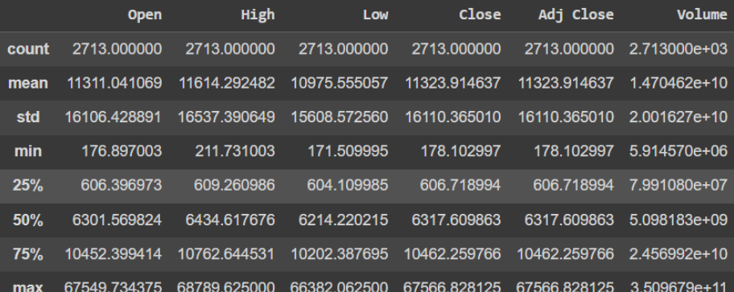
CODE:
import numpy as np
import pandas as pd
import matplotlib.pyplot as plt
import seaborn as sb
from sklearn.model_selection import train_test_split
from sklearn.preprocessing import StandardScaler
from sklearn.linear_model import LogisticRegression
from sklearn.svm import SVC
from xgboost import XGBClassifier
from sklearn import metrics
import warnings
warnings.filterwarnings('ignore')
df = pd.read_csv('bitcoin.csv')
df.head()

Slide 11
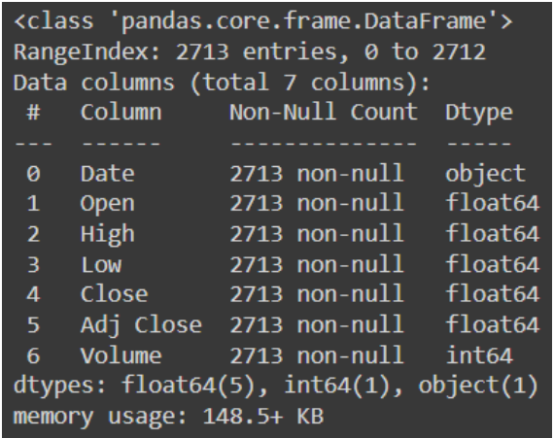
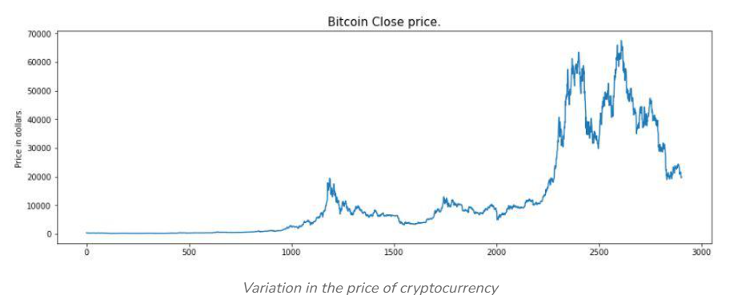
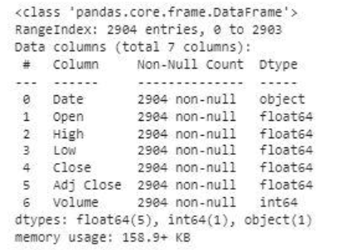
CODE:
OUTPUTS:
(2713, 7)
df.shape
df.describe()
df.info()
plt.figure(figsize=(15, 5))
plt.plot(df['Close'])
plt.title('Bitcoin Close price.', fontsize=15)
plt.ylabel('Price in dollars.')
plt.show()

Slide 12
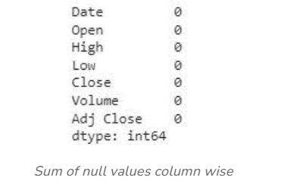
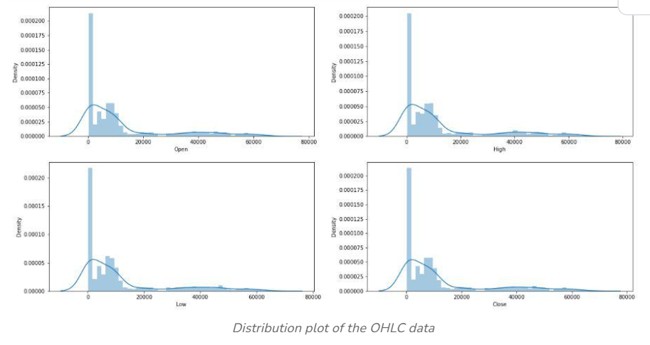
CODE:
OUTPUT:
df[df['Close'] == df['Adj Close']].shape, df.shape
((2713, 7), (2713, 7))
df = df.drop(['Adj Close'], axis=1)
df.isnull().sum()
features = ['Open', 'High', 'Low', 'Close']
plt.subplots(figsize=(20,10))
for i, col in enumerate(features):
plt.subplot(2,2,i+1)
sb.distplot(df[col])
plt.show()

Slide 13
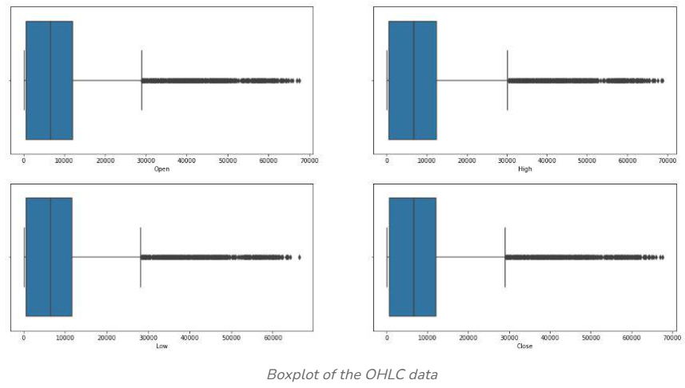
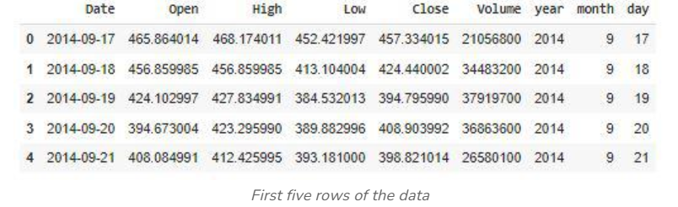
CODE:
OUTPUT:
plt.subplots(figsize=(20,10))
for i, col in enumerate(features):
plt.subplot(2,2,i+1)
sb.boxplot(df[col])
plt.show()
splitted = df['Date'].str.split('-', expand=True)
df['year'] = splitted[0].astype('int')
df['month'] = splitted[1].astype('int')
df['day'] = splitted[2].astype('int')
# Convert the 'Date' column to datetime objects
df['Date'] = pd.to_datetime(df['Date'])
df.head()
# This code is modified by Susobhan Akhuli

Slide 14

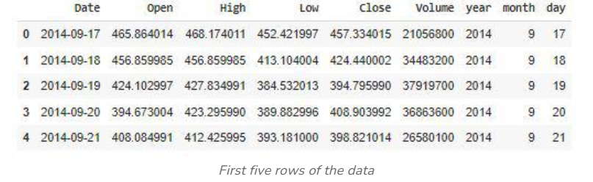
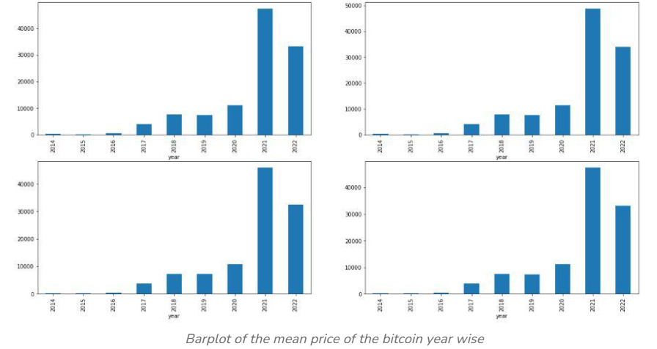
plt.subplots(figsize=(20,10))
for i, col in enumerate(features):
plt.subplot(2,2,i+1)
sb.boxplot(df[col])
plt.show()
splitted = df['Date'].str.split('-', expand=True)
df['year'] = splitted[0].astype('int')
df['month'] = splitted[1].astype('int')
df['day'] = splitted[2].astype('int')
df['Date'] = pd.to_datetime(df['Date'])
df.head()
data_grouped = df.groupby('year').mean()
plt.subplots(figsize=(20,10))
for i, col in enumerate(['Open', 'High', 'Low', 'Close']):
plt.subplot(2,2,i+1)
data_grouped[col].plot.bar()
plt.show()
df['is_quarter_end'] = np.where(df['month']%3==0,1,0)
df.head()

Slide 15
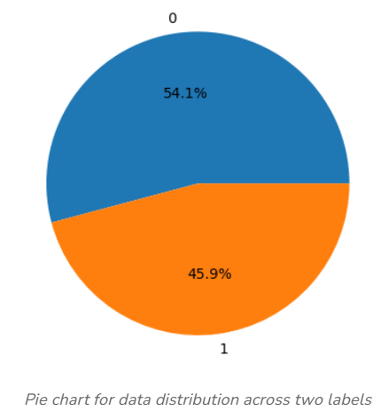
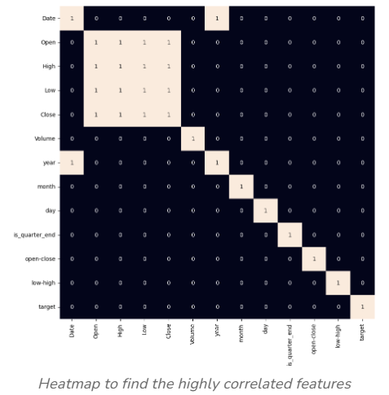
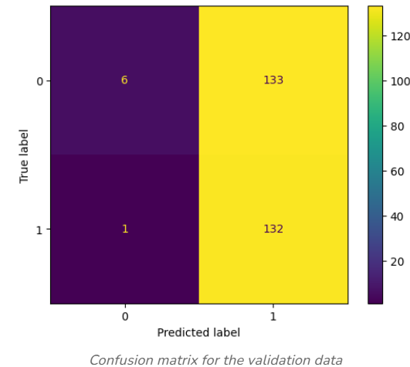
plt.pie(df['target'].value_counts().values,
labels=[0, 1], autopct='%1.1f%%')
plt.show()
plt.figure(figsize=(10, 10))
sb.heatmap(df.corr() > 0.9, annot=True, cbar=False)
plt.show()
features = df[['open-close', 'low-high', 'is_quarter_end']]
target = df['target']
scaler = StandardScaler()
features = scaler.fit_transform(features)
X_train, X_valid, Y_train, Y_valid = X_train, X_valid, Y_train, Y_valid = features[:len(features)//7],features[len(features)//7:],target[:len(features)//7],target[len(features)//7:]
from sklearn.metrics import ConfusionMatrixDisplay
ConfusionMatrixDisplay.from_estimator(models[0], X_valid, Y_valid)
plt.show()
models = [LogisticRegression(), SVC(kernel='poly', probability=True), XGBClassifier()]
for i in range(3):
models[i].fit(X_train, Y_train)
print(f'{models[i]} : ')
print('Training Accuracy : ', metrics.roc_auc_score(Y_train, models[i].predict_proba(X_train)[:,1]))
print('Validation Accuracy : ', metrics.roc_auc_score(Y_valid, models[i].predict_proba(X_valid)[:,1]))
print()

Slide 16
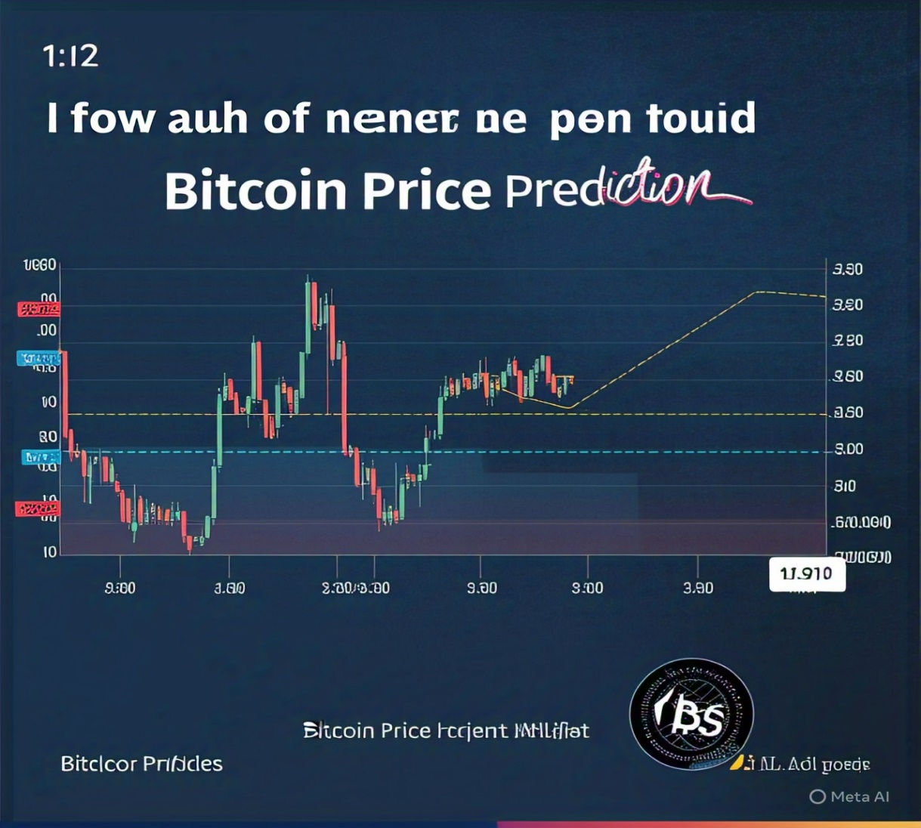
Result

Slide 17
Conclusion
Bitcoin price prediction using machine learning offers promising insights into market trends and price fluctuations. While models like LSTM, XGBoost, and Random Forest can capture complex patterns, their accuracy depends on high-quality data, proper feature selection, and market volatility management.
However, despite advancements, challenges such as unexpected market events, regulatory changes, and investor sentiment make perfect predictions difficult. ML models can improve trading strategies, risk management, and financial decision-making but should be complemented with traditional analysis techniques.
Ultimately, machine learning enhances forecasting but should be used as a support tool rather than an absolute decision-maker in financial markets. 🔍📈

Slide 18
Future scope
Discuss potential enhancements and expansions for the system. This could include incorporating additional data sources, optimizing the algorithm for better performance, and expanding the system to cover multiple cities or regions. Consider the integration of emerging technologies such as edge computing or advanced machine learning techniques.

Slide 19
References
List and cite relevant sources, research papers, and articles that were instrumental in developing the proposed solution. This could include academic papers on bike demand prediction, machine learning algorithms, and best practices in data preprocessing and model evaluation.
GitHub Link: Link

Slide 20
Thank you

